Slide 1
Coursera Capstone Project : Applied Data Science
Manish

Slide 2
Overview
Introduction Business Problem Data
Neighbourhoods Geocoding Venue Data
Methodology
Accuracy of the Geocoding API Folium
One hot encoding
Top 10 most common venues Optimal number of clusters K-means clustering
Results Discussion Conclusion

Slide 3
Introduction
Train stations are ideal locations for small businesses to set up shops, because they are hubs of human interaction where hundreds or even thousands of people day and night come and go.
Each person in this flow of foot traffic is a potential customer who might need a specific item or purchase on impulse while waiting for a train.
To succeed with retail at a train station, one must provide an accessible and affordable shopping experience offering merchandise or services that travellers might not quickly find elsewhere en route while travelling.

Slide 4
Business Problem
Train passengers as well as station and train employees need to eat breakfast, lunch, dinner and snacks. Foods that attract busy people on the go include egg sandwiches, fries, pizza, burgers, microwaveable or cold prepared meals. Beverages such as coffee, tea, wraps, bottled water, soda and juice also sell well.
The main objective is to find ideal spots in the city where fast food retail chains can be put up, aiming at the above demographic and maximize profits out of them.

Slide 5
Data
Venue Data
From the location data obtained after Web Scraping and Geocoding, the venue data is found out by passing in the required parameters to the FourSquare API, and creating another DataFrame to contain all the venue details along with the respective neighbourhoods.

Slide 6
Methodology
Accuracy of the Geocoding API
In the initial development phase with OpenCage Geocoder API, the number of erroneous results were of an appreciable amount, which led to the development of an algorithm to analyze the accuracy of the Geocoding API used.
In the algorithm developed, Geocoding API from various providers were tested, and in the end, Google Maps Geocoder API turned out to have the least number of collisions (errors) in our analysis.
Folium
Folium builds on the data wrangling strengths of the Python ecosystem and the mapping strengths of the leaflet.js library. All cluster visualization are done with help of Folium which in turn generates a Leaflet map made using OpenStreetMap technology.

Slide 7
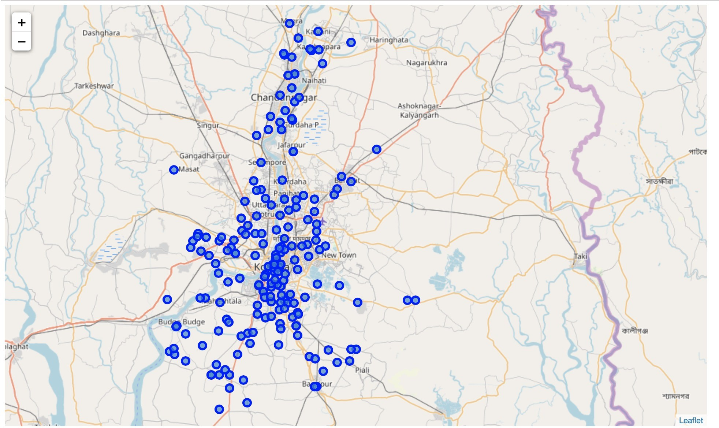
Methodology
Figure: Neighbourhoods .

Slide 8
Methodology
Optimal number of clusters
Silhouette Score is a measure of how similar an object is to its own cluster (cohesion) compared to other clusters (separation).
The silhouette ranges from -1 to +1, where a high value indicates that the object is well matched to its own cluster and poorly matched to neighboring clusters.
Based on the Silhouette Score of various clusters below 20, the optimal cluster size is determined.

Slide 9
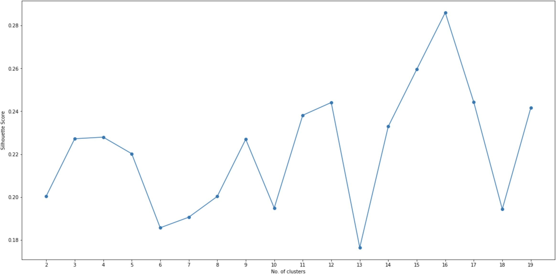
Methodology
Figure:Silhouette score vs No.of clusters.

Slide 10
Methodology
K-means clustering
The venue data is then trained using K-means Clustering Algorithm to get the desired clusters to base the analysis on.
K-means was chosen as the variables (Venue Categories) are huge, and in such situations K-means will be computationally faster than other clustering algorithms.

Slide 11
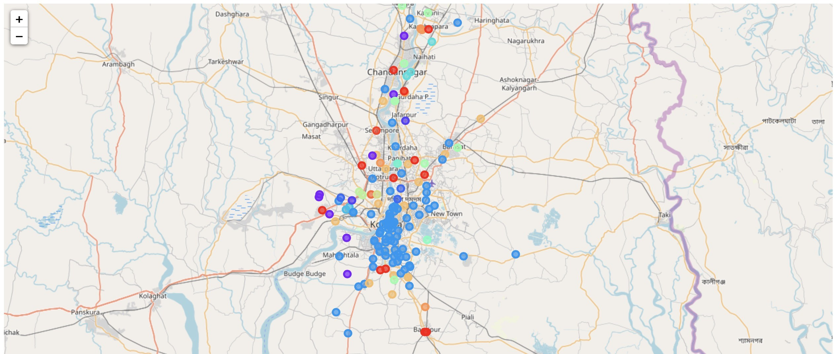
Results
The neighbourhoods are divided into n clusters where n is the num- ber of clusters found using the optimal approach. The clustered neighbourhoods are visualized using different colours so as to make them distinguishable.
Figure:Neighbourhoods of Kolkata (Clustered).

Slide 12
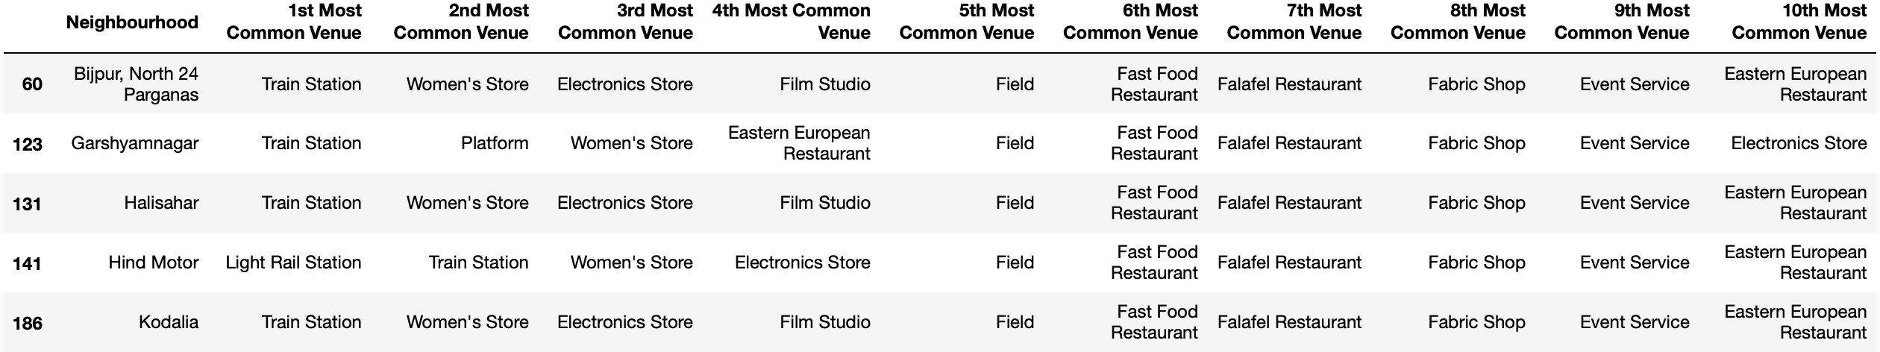
Discussion
The five places namely Bijpur, Garshyamnagar, Halisahar, Hind Motor and Kodalia fall in the outskirts of the city of Kolkata, hence the demographic of the population in these areas fall under the lower middle class of the society.
Figure:Cluster having Train Station as most common venue

Slide 13
Discussion
India is expected to see a dramatic growth in the middle class, from 5 to 10 percent of the population in 2005 to 90 percent in 2039, by which time a billion people will be added to this group.
In 2005, the mean per capita household expenditure was just US $3.20 per day, and very few households exceeded incomes of US $5 per day. Yet, by 2015, half the population had crossed this threshold. By 2025, half the Indian population is expected to surpass US $10 per day.
Source : Diana Farrell and Eric Beinhocker. “Next Big Spenders: India’s Middle Class,” McKinsey Inc., May 19, 2007.

Slide 14
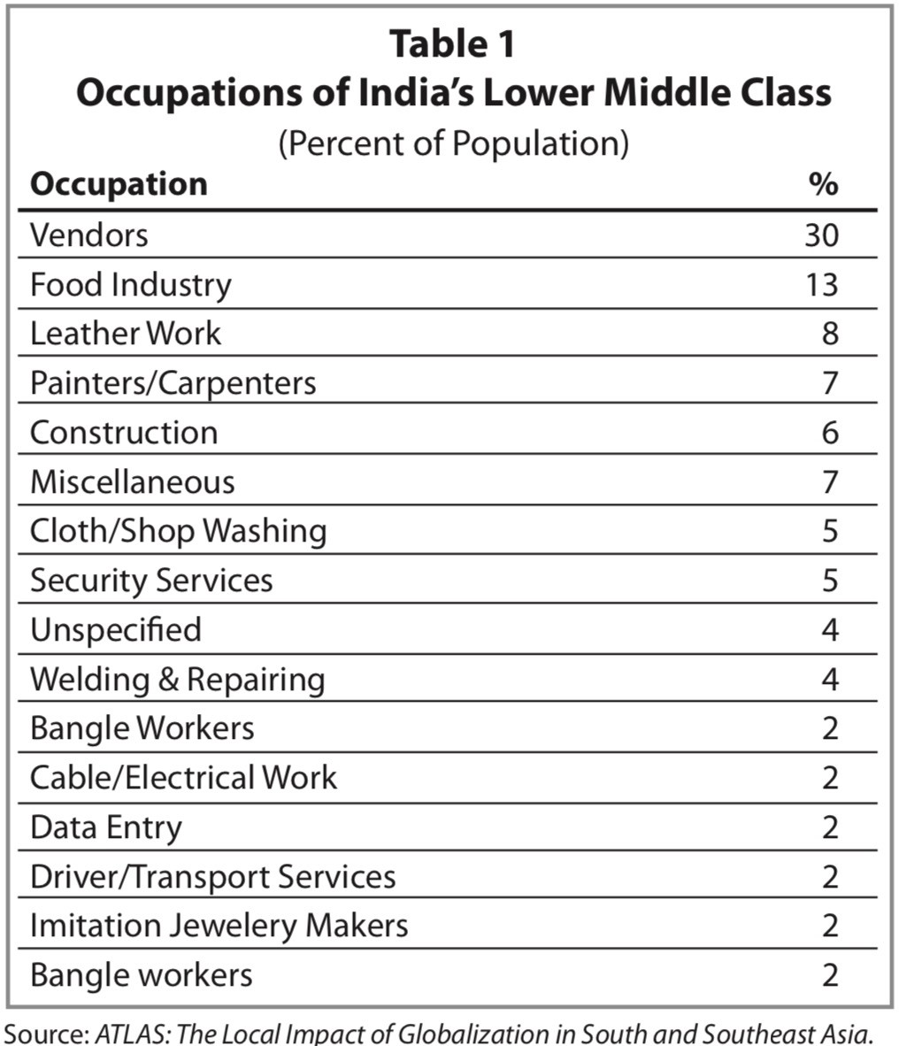
Discussion
Figure:Occupation of Indian’s Lower Middle Class

Slide 15
Conclusion
As the middle class will grow at a rapid rate in the next upcoming years, opening food outlets catered to the needs of that section of the society will see a massive increase in footfall, which would lead to a further increase in business.
If the food outlets have an average rate of US $0.5 equivalent to 15 percent of the per capita household expenditure, for their items, then profits can be expected to be high as the food rate is neither too low or too high for a person of the concerned demographic to spend.
Assuming a footfall of 30 people getting off at these stations for each train, 100 trains passing through these stations daily, and a conversion rate of 20 percent, ordering only one meal, a daily turnover of around US $300 can be expected from these outlets per station.

